Slide 1
Version Control with GIT
Chris Baldassano
PSYC GR6130, Fall 2019

Slide 3
Version Control
Features for academic research:
Keep track of all versions of your analysis code, allowing you to “get back” to any past state of your code and identify when changes were made
Keep an off-site backup of your work
Easily collaborate with others, and later share your analysis publicly
Track versions of other parts of your project, including manuscripts

Slide 4
GIT
There used to be many competing systems of software for version control, but in 2019 one is king: Git
Created by Linus Torvalds, to manage Linux source code
Many different interfaces, but we will focus on the basic command-line version
Notoriously confusing:
Conceptually complicated – we will try to cover this today
Confusing commands and unhelpful error messages – I apologize in advance, this was written by ultra-nerds

Slide 6
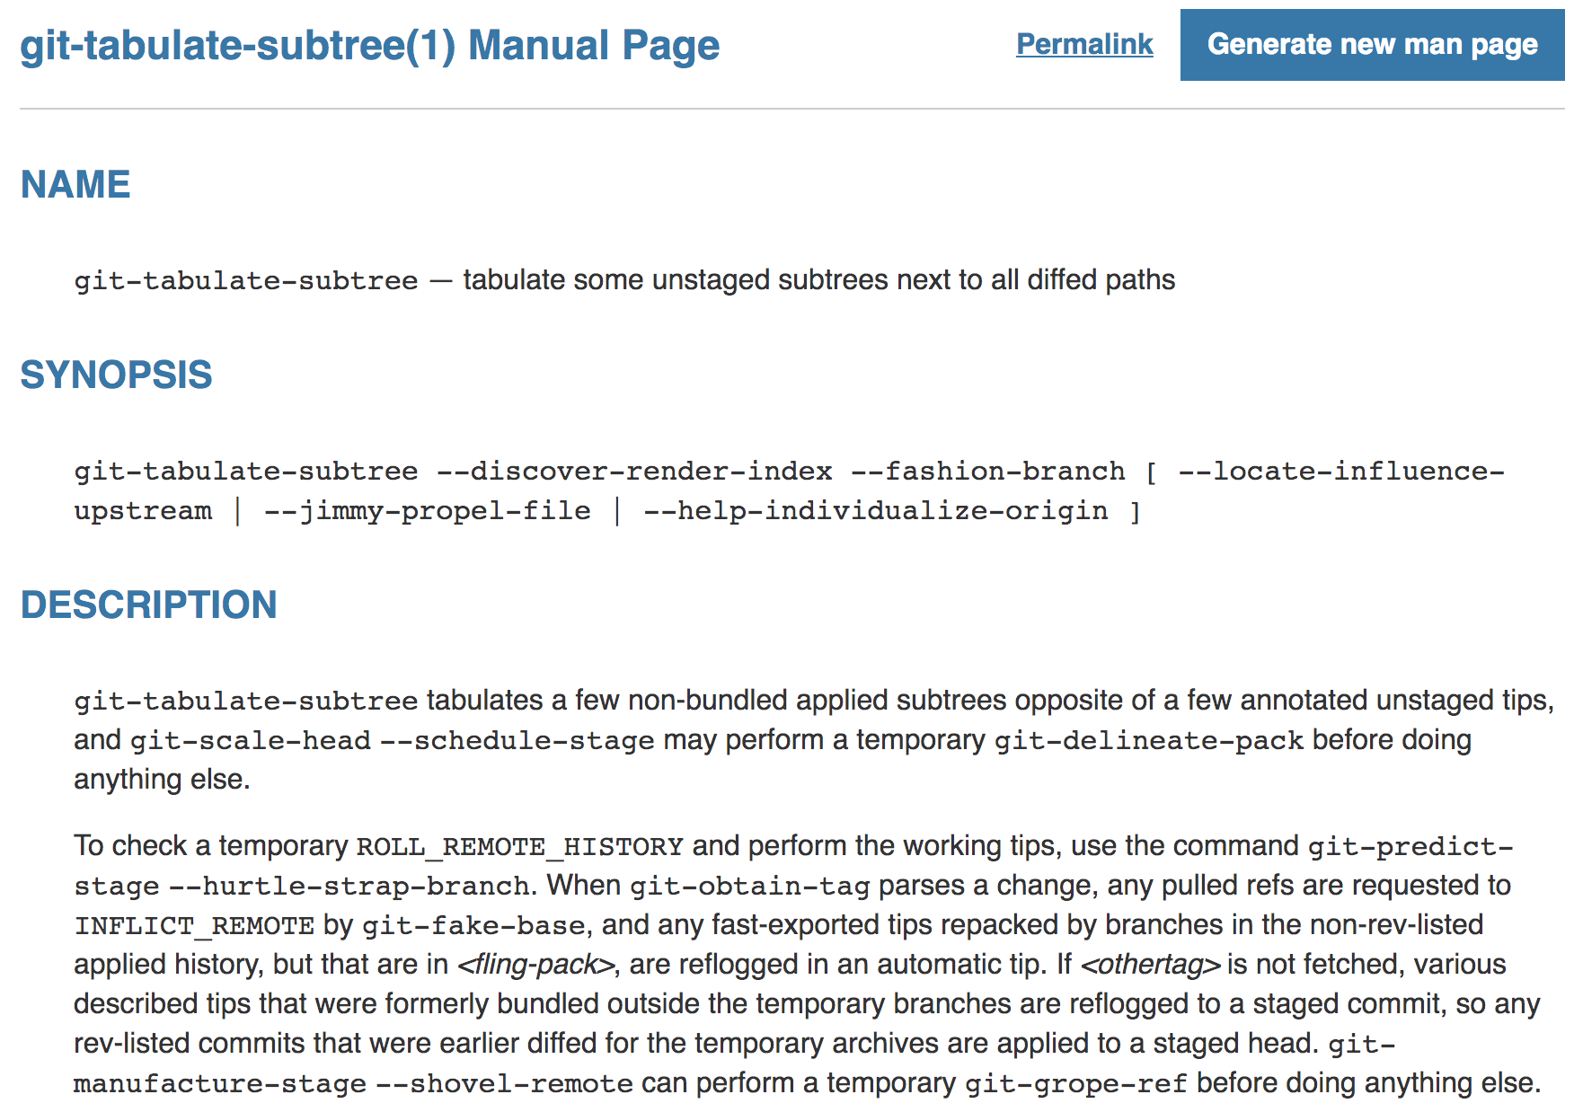
Git Man Page Generator
https://git-man-page-generator.lokaltog.net/

Slide 7
Locations in GIT
Files live in one (or more) of four locations:
Working directory: files on your hard drive (may not even be currently tracked by Git)
Staging area: files/changes that we are collecting together to form a single commit (snapshot)
Local repository: List of all commits, maintained on our local machine
Remote repository: List of all commits, maintained on a remote machine (for us, this will always be GitHub)

Slide 8
/pull
https://greenido.files.wordpress.com/2013/07/git-local-remote.png?w=696&h=570

Slide 9
Git Commits
When working with code, it makes more sense to snapshot sets of files together, rather than maintaining a separate version history for each one (since files depend on each other)
But we may not want to snapshot every single file we are working on – maybe some are in an awkward in-progress state that would confuse our collaborators
So any time we want to create a new commit, we first add (new or existing) files to a staging area, and then commit them as a group into our local repository

Slide 10
http://swcarpentry.github.io/git-novice/04-changes/index.html

Slide 11
Remote repositories
Git works fine with just a local repository of commits, but we usually want to:
Back up our work
Work on multiple computers or collaborate with others
Publicly share our work
For this, we can synchronize our local repository to some shared remote repository
We’ll be using GitHub, which is by far the most popular
Could also use other services (e.g. BitBucket) or host your own
When viewing someone else’s Git repository online, this is what you are looking at

Slide 12
Typical Collaborative Workflow
Get changes anyone has made to the shared remote repository and merge them into your local repository (git pull)
Make changes to files
Stage some set of files you want to snapshot (git add)
Commit these changes to your local repository (git commit)
Upload commit(s) to the remote repository (git push)
Don’t have to do this on every commit – you may want to be snapshotting your work even before you are ready to share it with others by pushing to the remote repository

Slide 13
Comparing Prior Versions
For looking at version history, can use command-line git (git diff and git show) but generally much easier to use GitHub’s web-based interface
Every commit has both a text commit message (specified by the user for every git commit) as well as a name (hash)

Slide 14
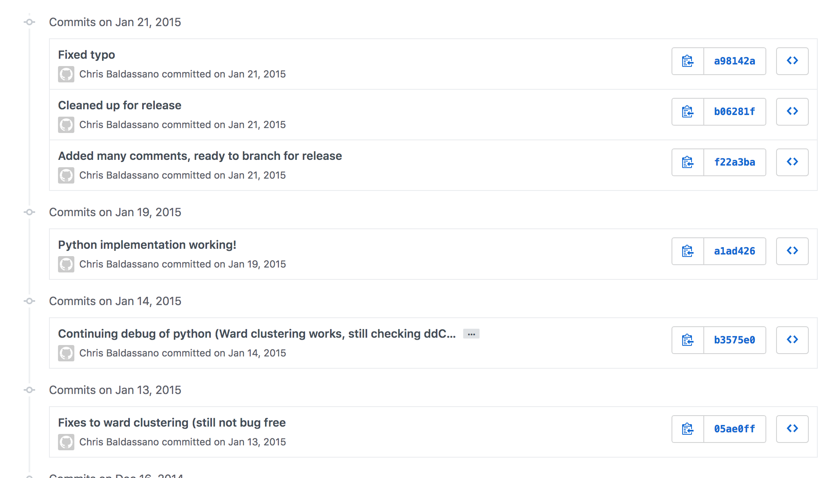

Slide 15
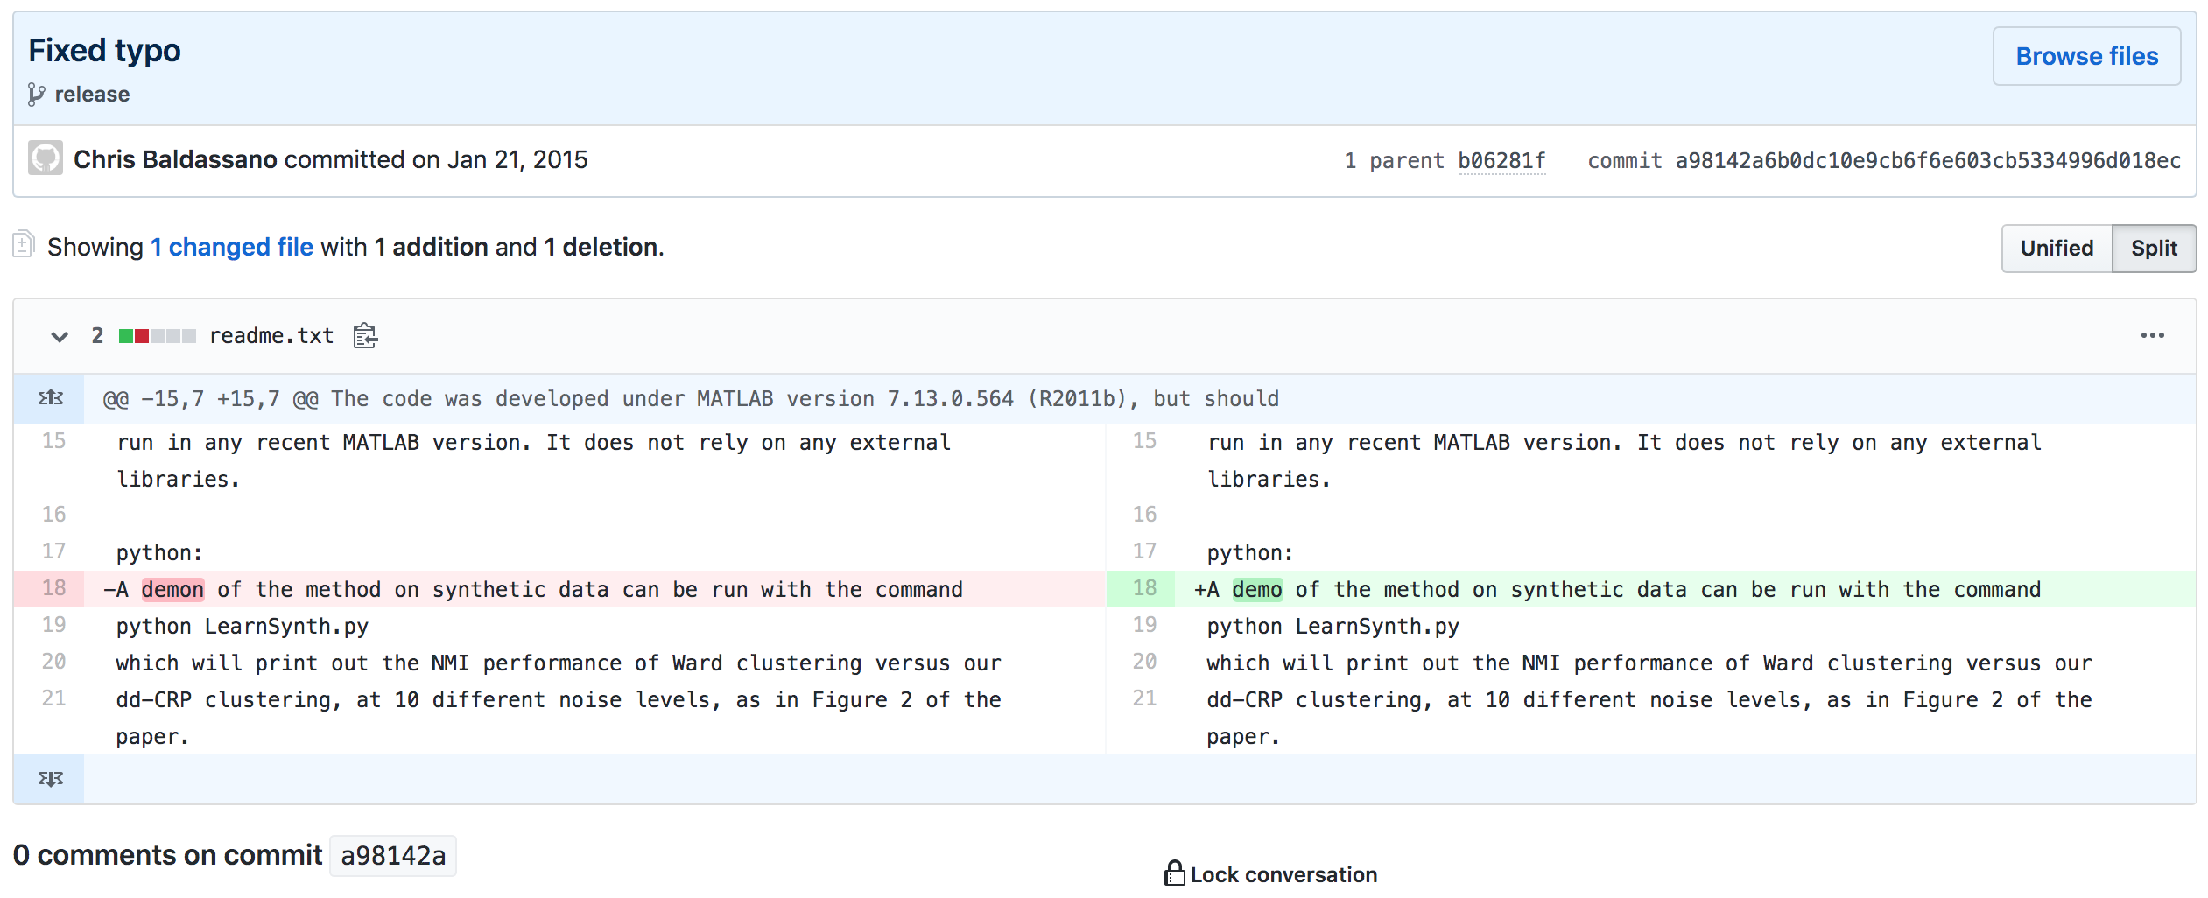

Slide 16
Reverting to prior versions
We can overwrite a file in our working directory with a version of that file from a prior commit, using git checkout [HASH] [file]
We need to specify the (short) hash name of the commit that we want to grab from
This allows us to:
Revert unsaved changes to a file, by checking out the most recently committed version
Go back to an older version, by checking out an older commit
If we want to make this the new “current” version, we need to use git add and git commit after checking it out, to make the most recent snapshot be this older version

Slide 17
Branches
Say you and one of your co-authors want to work on the writing the methods section of a paper, but don’t want to bother the other authors with each of your changes until it is in good shape to get comments
Git allows you to fork off your work into a separate branch, and then later merge this branch back into the main list of commits

Slide 18
Branch and HEAD Pointers
A branch in Git is simply a moveable pointer to a commit
The HEAD pointer tracks which branch you are currently using, and moves the branch pointer to keep it pointing at the most recent commit along this branch
Using git checkout [branch] switches your HEAD pointer to that branch, and changes all the files in your working directory to reflect that commit

Slide 19
Branch and HEAD Pointers
https://git-scm.com/book/en/v2/Git-Branching-Branches-in-a-Nutshell

Slide 20
Branch and HEAD Pointers
git branch testing
https://git-scm.com/book/en/v2/Git-Branching-Branches-in-a-Nutshell

Slide 21
Branch and HEAD Pointers
git checkout testing
https://git-scm.com/book/en/v2/Git-Branching-Branches-in-a-Nutshell

Slide 22
Branch and HEAD Pointers
git commit
https://git-scm.com/book/en/v2/Git-Branching-Branches-in-a-Nutshell

Slide 23
Branch and HEAD Pointers
git checkout master
https://git-scm.com/book/en/v2/Git-Branching-Branches-in-a-Nutshell

Slide 24
Branch and HEAD Pointers
git commit
https://git-scm.com/book/en/v2/Git-Branching-Branches-in-a-Nutshell

Slide 25
Merging branches
Usually we eventually want to apply the changes in our branch back to the master branch
A merge commit has two parents, from two different branches

Slide 26
Merging branches
git checkout master
https://git-scm.com/book/en/v2/Git-Branching-Basic-Branching-and-Merging

Slide 27
Merging branches
git merge iss53
https://git-scm.com/book/en/v2/Git-Branching-Basic-Branching-and-Merging

Slide 28
Downsides of Git
Intended only for plain-text files
For non-text but small files, still works ok (just don’t get meaningful difference comparisons)
For large files, things start getting very slow
“Git large file storage” – large files are stored outside the repository, but git maintains a pointer to where the file lives
Some Git commands (e.g. checkout) will change files on your hard drive (usually with a warning) – you should be willing to lose anything you haven’t checked in as a commit, Git takes no responsibility!

Slide 29
Lab Instructions
Open assignment: https://classroom.github.com/a/ANUi4sX-
Click “Clone or Download” to get repository URL
In terminal, type git clone [URL] to get a local copy
Start Jupyter Lab through Anaconda Navigator, open Exercises.ipynb

